Slide 1
Game Development 2B
Trees

Slide 2

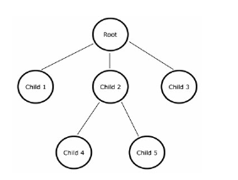
trees
Common structure in Computer Science
Non linear
Hierarchy
Usually binary tree (max 2 children)
2-3-4 trees (up to 4 children)

Slide 3
Tree structure and terminology
Root Node: Top of the tree
Edge: Connection from one node to another
Child node: Node that is connected to some common parent higher in the hierarchy
Sibling node: Node across the same hierarchy level
Leaf node: End nodes in a tree structure
Key value: Element value of Node
Relationship between nodes is parent-child

Slide 4
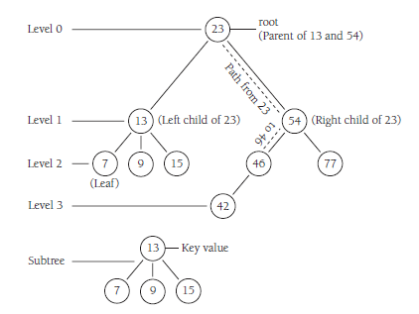
Traversing a tree structure
Traversal happens through the edges of a tree structure
How do we get to 42 from 23?
Traversal occurs down levels as you move down the branch
Root is Level 0
42 is on Level 3

Slide 5
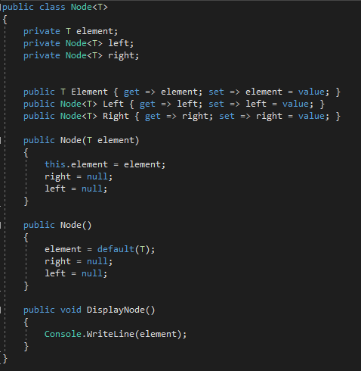
Creating a binary search tree node

Slide 6
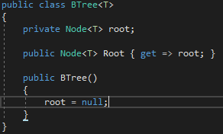
The binary search tree class
The tree is built on nodes
All we need is a root node

Slide 7
Inserting into a tree
Does our tree have a root? If not, root = newNode – same as LinkedList
If we have a root node, we have to traverse to see where our new node fits in with other nodes
This is what makes a Btree so efficient – everything is sorted in some value set in order to do proper insertion
Makes access quicker

Slide 8
Tree insertion
Set the parent node to be the current node, which is the root node.
1
If the data value in the new node is less than the data value in the current node, set the current node to be the left child of the current node. If the data value in the new node is greater than the data value in the current node, skip to Step 4.
2
If the value of the left child of the current node is null, insert the new node here and exit the loop. Otherwise, skip to the next iteration of the While loop.
3
Set the current node to the right child node of the current node.
4
If the value of the right child of the current node is null, insert the new node here and exit the loop. Otherwise, skip to the next iteration of the While loop.
5

Slide 9
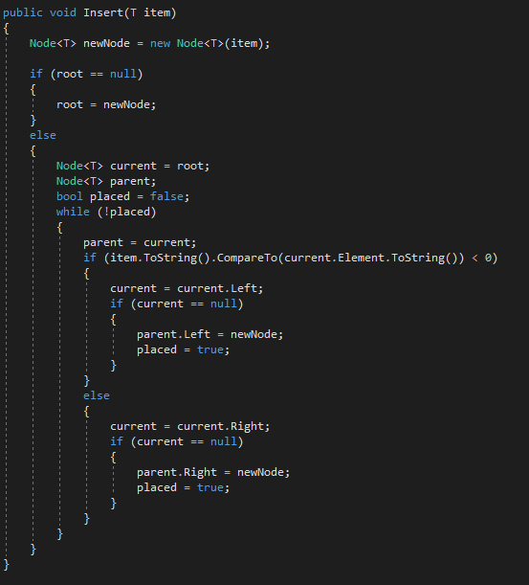
Insert method

Slide 10
traversal
Inorder traversal visits tree nodes in ascending order regardless of how the tree was initially constructed
1
Preorder traversal visits all the root’s left child’s tree, then the right – this makes the most traditional sense when we think of output
2
Postorder traversal traverses the tree from the bottom levels up on a level by level basis
3

Slide 11
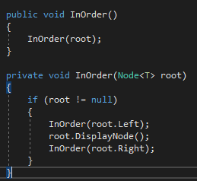
Traversal and recursion
Traversal in all cases uses recursion, calling the same function repetitively to move down the tree by providing the function with a different “root” each time, and then popping back up the call stack when it’s done
Let’s examine this with inorder traversal

Slide 12
Traversal and recursion
Build the tree
tree.Insert(50);
tree.Insert(45);
tree.Insert(47);
tree.Insert(46);
tree.Insert(51);
tree.Insert(65);
tree.Insert(99);
tree.Insert(22);

Slide 13
50
45
47
51
22
46
65
99

Slide 14
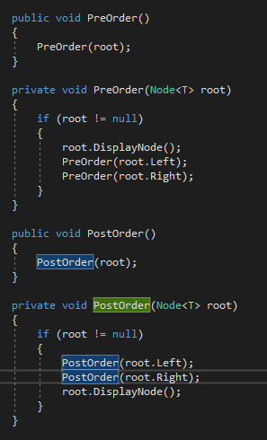
Other Traversal methods

Slide 15
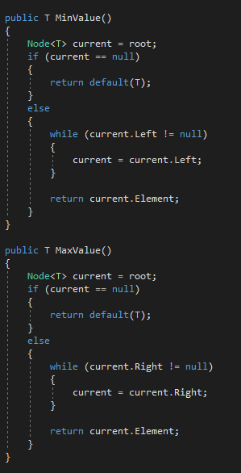
Min and max values

Slide 16
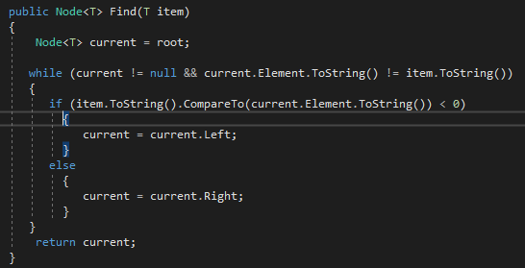
Finding a vaLUE

Slide 17
Removal cases
The node is a leaf
The node has one child
The node has 2 children

Slide 18
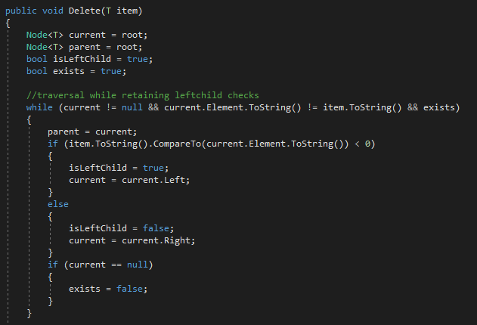
traversal

Slide 19
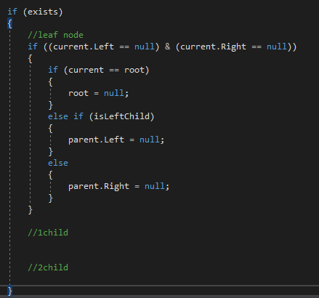
Leaf removal
Check if leaf is root
Which side of parent do we set to null – left or right?

Slide 20
Node deletion with one child
Which side is the one child on – left or right?
We need to reassign this correctly to our parent node
Which side are we on? Because this dictates how we do the switch

Slide 21
Node deletion with one child
23
21
Deleting 23
Our left child has an element:
The left child (21) should be the new root of the subtree (keeps data validity)
If deleted node is root, new root is current.left

Slide 22
Node deletion with one child
23
21
27
25
Deleting 23
Our node is a left child
Has a left or right child
Our left/right needs to be the left/right of our parent depending on how our child relates to our parent
Anything on the left side of a tree will always be smaller than the new root, so it’ll reshuffle to left
Anything on the right side will be larger, so it’ll reshuffle to right

Slide 23
50
52
45
30
55

Slide 24
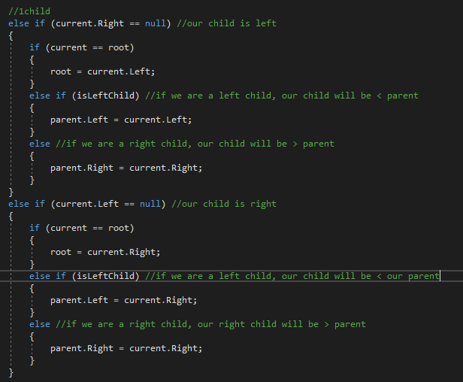
One child node deletion

Slide 25
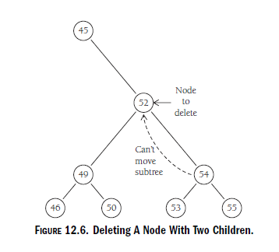
Moving subtrees

Slide 26
Moving to the inorder successor
Move the smallest leaf in the targeted node’s right subtree into its position
1
Keeps integrity of the tree without changing the structure
2
The smallest leaf is still going to be smaller than the rest of the parent branches
3

Slide 27
Tree example
25
23
21
24
29
27
31
26

Slide 28
Tree example
If we delete 23, 24 as a successor keeps integrity
If we delete 29, 31 as a successor keeps integrity

Slide 29
25
23
29
27
31
26
21
24
33
30
34
35

Slide 30
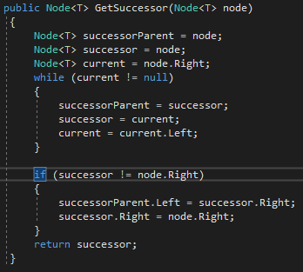
Get successor

Slide 31
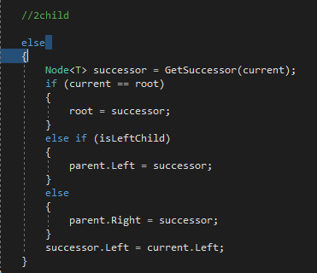
Two child deletion

